Slide 1

Dividni individualised multiple-choice assessments
An Overview
Notes:
Welcome everyone! This video gives an overview of why you might want to use Dividni individualised assessments and how they work – from authoring your questions to grading.
We’ll first take a look at what makes organising, running and marking conventional mid-semesters tests and exams so hard, and we’ll then look at how Dividni can make this job a lot easier.

Slide 2
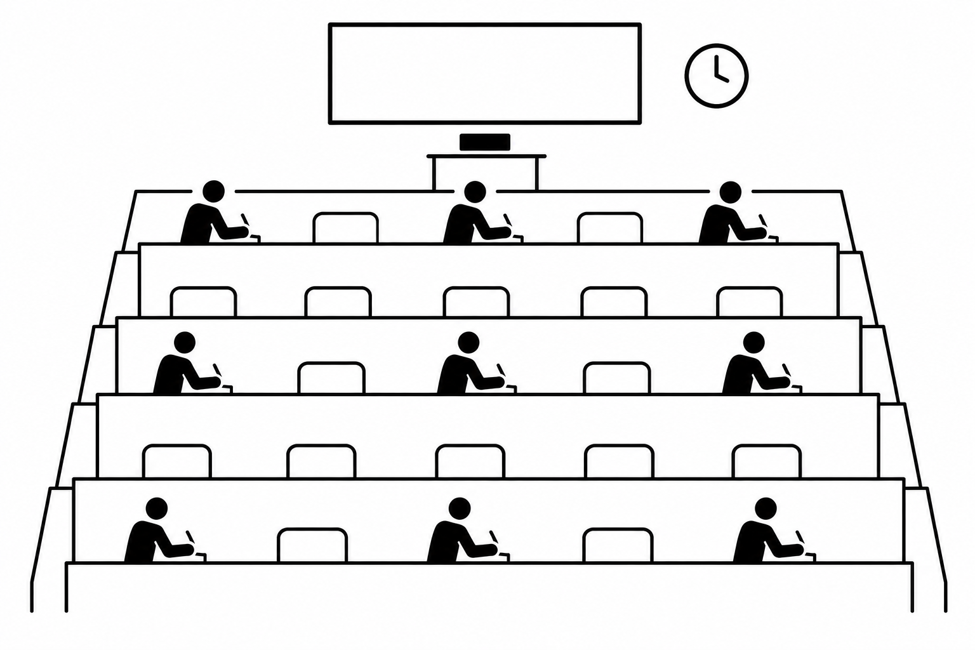
Organising a mid-semester test or exam is hard work …
Authoring enough new / changed questions every year to keep the assessment challenging
Finding venues:
  Exam-style seating one apart to make cheating harder
  Finding enough theatres at crunch time (evenings middle of the semester)
Staffing: Finding enough (volunteer) invigilators
Root of the problem:
Insufficient difference between test/exam scripts to prevent cross-fertilisation between students
Notes:
Now you would probably have been organising tests or exams for large classes before, and you know the drill. Each semester, your wreck your brain to come up with new questions that students haven’t seen before and therefore can’t memorise the answer for that question without understanding what makes the answer the answer.
You’ve probably also had to find venues for your tests, so you know it’s a Catch-22: You can’t seat students shoulder-to-shoulder because you know that a significant number will just looks sideways and copy answers from their neighbours. So you can’t run your test during lecture time. And because all of the larger theatres are booked for most of the day, you have to run your test in the evenings, and there at mid-semester time you now compete against all the other large courses that also want to run their tests the same evening.
So you’ll have to put up with more but smaller theatres, and that immediately presents you with the next problem: You’ll have to find people to help you invigilate. So you have to lean on colleagues and PhD students working as tutors and markers and whoever you can get hold off to give up their evening off in order to help you invigilate. If you’re like me, you’ll probably dread having to ask for favours each time.
But let’s take a step back and look at where the root of the problem here really is: It’s the fact that there isn’t enough difference between two test or exam scripts to prevent students looking sideways for inspiration. This is what forces us to go to all that length.

Slide 3
Running a mid-semester test or exam is hard work …
Coordination between venues on the day
Managing academic integrity – four versions of an MCQ exam aren’t secure enough
Dealing with special conditions, latecomers, aegrotats, and other exceptions
Root of the problem:
Insufficient difference between test/exam scripts to prevent cross-fertilisation between students
Notes:
Of course, once you’ve organised the test or exam, the issues continue on the day: Invigilators fail to turn up, or find that venues are locked, or ignore invigilation instructions – for example about reading time – and before you know it, you have complaints from students.
Likewise you still have to watch out big time for sideways glances – even the four version teleform exams and tests we used to have aren’t truly secure: People just look at the answers on the teleform sheet of one of their (hopefully stronger) classmates with the same version number seated in front of them and copy them. Exams Office have seen a wee bit of that activity – in fact, it was such an exam that led to Dividni being developed in the first place.
And of course, you’ll be familiar with students sitting under special conditions, students who turn up late or have forgotten that the test was on, or whose bus or train got stuck. And those who just can’t make it to the test because they work full-time and their boss has just told them that they need to go onto a business trip that day. Plus there are those who apply for aegrotats – and at least for our courses we know that “commercial” providers of fake medical certificates are actively marketing to our students with the promise that they will get computed grades from insecure assessments. But once you have run your main test or exam, the questions are effectively out in the open and a student could simply memorise the answers if you just offered a resit. But the alternative, making up a special test exam for stragglers, is a lot of work again.
Again, the common thread here why all of this becomes an issue is because there isn’t enough difference between individual test or exam scripts to rule out cross-fertilisation.

Slide 4
Marking a mid-semester test or exam is hard work …
Marking scripts consistently and in a timely manner
Equipment bottlenecks (Teleform scanners)
Teleform scans were not properly quality-assured
Teleform returned in a generic format and required significant additional processing to grade and to get to a Canvas-uploadable CSV file
Root of the problem:
Reliance on manual workflows and specialised staff / bottleneck equipment
Notes:
OK, so now you’ve run your test or exam and now the race is on to get it marked and to get feedback returned to students. Now how long does this usually take you? A few days? A couple of weeks? More than a couple of weeks? Does the long time to feedback regularly feature in your student feedback reports as something that could be improved?
Well, when we still had the teleforms, for those of use who used them, some of that delay was beyond our control because we relied on Assessment Services’ sole teleform scanner and their part-time staff, who had a pile of tests and exams to work through each semester.
And when we go the scan results back – remember that funny text file? We all had to come up with our own software or manual solution for grading and to get to something we could upload to Canvas and that we could use to give students feedback from. Plus when students got their IDs wrong, that would usually show up late in the process only and caused a lot of manual work to fix.
Of course, the common factor here is different: It’s the reliance on manual workflows and on bottleneck resources in terms of equipment and specialised staff. So even teleforms were never a really scaleable solution.

Slide 5
There’s got to be a better way, right?
There is: Dividni
Notes:
So you’d think that there’s got to be a better and more efficient way of doing things, and there is: Dividni, or more precisely the part of the Dividni ecosystem that deals with individualised multiple-choice question generation on paper.
By the way, Dividni is the first part of “individual” spelled backwards.
So let’s have a look at how this works and why this solves most of the hard-work problems involved in organising, running and grading individualised multiple-choice tests and exams on paper.

Slide 6
Dividni workflow: the big picture
Ground truth answers for each version
Question authoring:
Question definition online via answer pools
Each question can exist in a myriad of variants
Script assembly:
Put together front matter, question selection, appendices and an OMR sheet* online
Versioning:
Automatically creates an individual version of the script for each student by individualising each question.
Printing:
Print one copy of each script version
*OMR = optical mark recognition – similar to a Teleform
Students sit test / exam on paper – each with their very own script version and submit the OMR sheet only
Student ID file
Scanning:
To PDF on any FollowMe photocopier / scanner on campus
Optical Mark Recognition: Upload PDF online and recognise student ID and answers automatically
Post-processing UI: Detect and fix ID issues and ambiguously answered questions semi-automatically
Grading UI: Use OMR results and ground truth answers to grade test / exam online in seconds
Canvas upload and student feedback
Notes:
So here is the big picture of how it all works. The thick blue arrows represent the timeline, which means it all starts in the top left corner with the question authoring. Now: Very important here – what you author for Dividni aren’t so much conventional multiple-choice questions – even though “questions” is what we call them – but questions that have true and false answer pools, which as we’ll see shortly allow us to produce one of these (in inverted commas) “questions” in a large variety of versions such that two different versions of the question don’t look very much alike anymore. This authoring can now be done via our new online user interface, and that’s as easy as just typing in the question stem and then two sets of statements or answer options – one set of which is true or correct in the sense of the question, i.e., these are the answer options we want students to select, and the other is the set of distractors. For those of you who would like to use formulas, you can include LaTeX in question stems and answer options as well, and it’s also possible to include images. Oh, and we can easily re-use questions from previous semesters – the versioning ensures that these don’t age all that quickly!
Once we have these questions, we can now use the same online user interface to assemble the questions into a complete script. For that, we need to add a cover sheet as you would do for any test or exam, any appendices we might want to have, and the OMR sheet which we’ll use to record the student answers. What we actually put together in this step is just a sample of what one version of the script might look like, but it does nail down the order of questions and the pagination and all the common information we want each script to have.
In the next step, we perform the versioning: If you want to use Dividni to its full potential, you will want at least as many versions as there are students in the class, so no two students can end up with the same version. Our new online user interface does this automatically for you – all you need to specify is how many versions you want, where you want the version numbers to start, and whether you’re doing the versioning for proofreading or for production. If you’re previously manually jumbled the order of answer options for four version Teleform tests or exams, you will find this a vastly faster and easier process and nowhere near as error-prone. It’ll even produce a single-file PDF with all scripts in the format that Assessment Services likes.
Once we have got our potentially hundreds of scripts, Dividni also gives us – for safekeeping – a copy of the ground truth, that is, the answers for each script version. We’ll need that later for grading. For now, we’ll send the PDFs or PDF that that Dividni produces for us to the printers – whether you print in-house or contract an outside supplier is up to you.
One the scripts come back printed, we can let our students sit the test or exam. Now note that if you’ve done a reasonably thorough job in the first step, the questions on the scripts in the different versions will be so fundamentally different that looking at one’s classmate’s answers does not convey significant advantages in answering one’s own version of the questions.
Which now means that we can seat students cheek to jowl in the usual lecture theatre during normal class time. No more booking large numbers of theatres. No more having to ask colleagues to give up their evenings. If we have multiple streams, we can let them sit time-shifted. Accommodating specials, latecomers and aegrotat resits becomes an absolute breeze.
Now at the end of the test or exam, we just collect the OMR sheets from the students. We can now scan these to PDF on just about any scanner – any of the university’s FollowMe printer-scanners on campus can scan to OneDrive, Dropbox, Google Drive or e-mail and any of these destinations will do. Moreover: You can do this yourself. No more waiting for the scanning office and its bottleneck scanner to scan in your forms. There are dozens of FollowMe printer-scanners on campus. One of them is bound to be on a corridor near you, and if that one doesn’t work, there’ll be another one not far away.
Once you have the OMR sheet scans as PDF on your computer, you can go to the Dividni OMR Processor website, which takes care of the next two steps. In the first step, you upload the PDF file with the scans and Dividni attempts to extract the student ID numbers and student answers. The next step handles the post-processing: If you contribute a file with student names and IDs here, Dividni helps you detect and fix erroneously or weakly-entered student IDs. It also flags questions that students didn’t answer or answered ambiguously, e.g., by shading two or more bubbles on the OMR sheet. You can correct such issues with a mouse click or two.
The next step performs the actual grading – so far, we’ve only determined which answer options the students ticked but not whether these were right or wrong. That’s where our ground truth comes in – we can now upload this together with the OMR Processor output to the online MCQ Grader interface and get a graded exam back that’s ready for pasting into a Canvas gradebook. We also get a detailed breakdown here on who got which question right as well as individual feedback for each student.
Now to give you an idea as to how long this takes: The whole bottom row of boxes for a class of 200 students takes us no more than 2-3 hours to complete, with a good chunk of that time being the paper-to-PDF conversion. If you run a test at midday, you can generally have grades and feedback returned by mid-afternoon. How does this compare to your current turnaround times?

Slide 7

How Dividni achieves individualisation – a sample question
Question stem
True (“Corrects”) answer pool
False (“Incorrects”) answer pool
Notes:
What makes Dividni individualisation so powerful? Very simple: Dividni does much more than randomise the order of answer options in each script version. It actually produces question versions with different sets of answer options for each version.
How does it do that? Well, here is a simple example of a so-called “truth” question definition viewed in what we call “preview mode”. Truth questions are questions that show the student five answer options, only one of which is the correct choice. What the preview mode here shows are the three parts of each question that you define as you create the question. The trivial bit is the question stem, although what you see here is that TRUE is in bold – so you can do a bit of formatting for that question stem also. But the real power lies in the two option pools: the True (or “Corrects”) answer pool that contains those options that we want students to pick as true or applicable from the options list, and the False (or “Incorrects”) answer pool that contains the options we want students to dismiss. Each pool can have as many options as you like – the more, the better – except that you need a minimum of one in the true pool and a minimum of four in the false pool – but your creative juices will soon discover that it’s usually easy to come up with many more.
Each time Dividni creates a script version that includes this question, it picks one of the answer options from the True pool and four options from the False pool, permutes them randomly and inserts the result into the script. It also keeps a ground truth record of which option in this version was the correct one – that’s important for the automated marking of the script later.
So let’s have a look at a few versions of the above question that you might find in the scripts of different students.

Slide 8
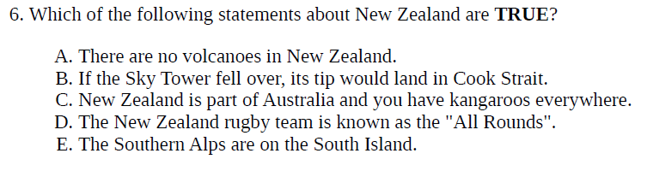
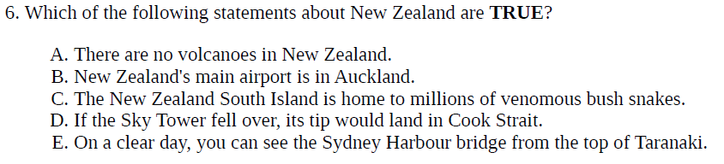
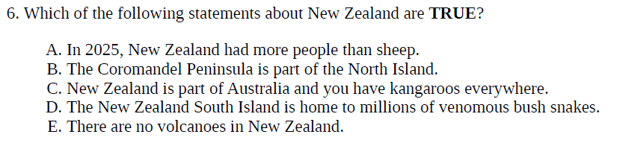
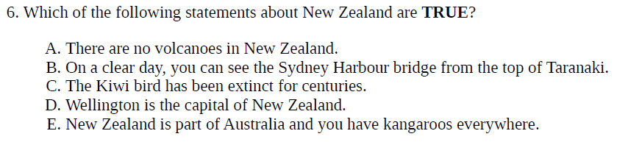
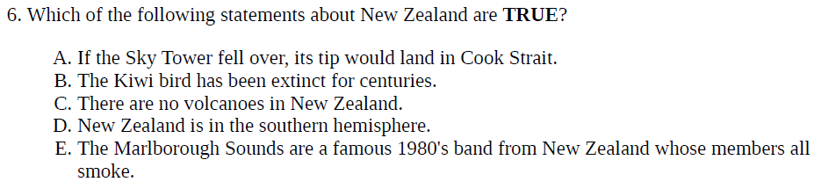
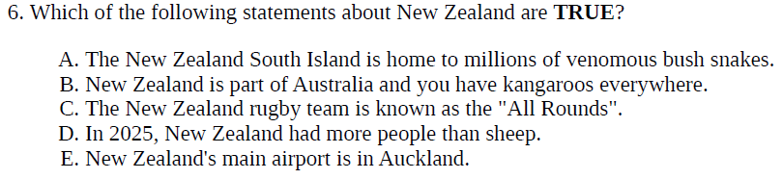
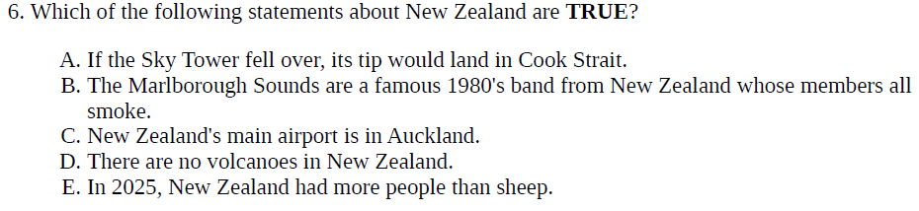
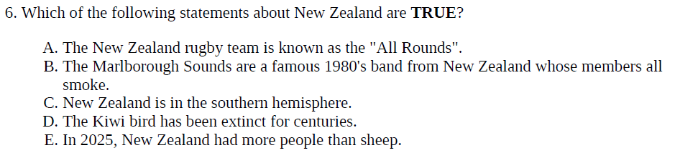
This sample question turns into many versions – one per script:
Notes:
So here are eight possible versions, but given the size of the pools, there are many, many more combinations. This now makes it much harder for students to just copy their neighbour’s answers. Moreover, memorising the correct answer for one of these questions is going to be of relatively little help for students sitting the same exam again at a future date – either as a re-sit following an aegrotat or next semester or next year, or the year thereafter. Learning the material now becomes an easier option compared to just memorising past answers.
But truth questions are only one of two question types in Dividni. The other question type uses the same kind of question definition but requires that each pool contain at least three statements. Let’s have a look what this question type looks like.

Slide 9
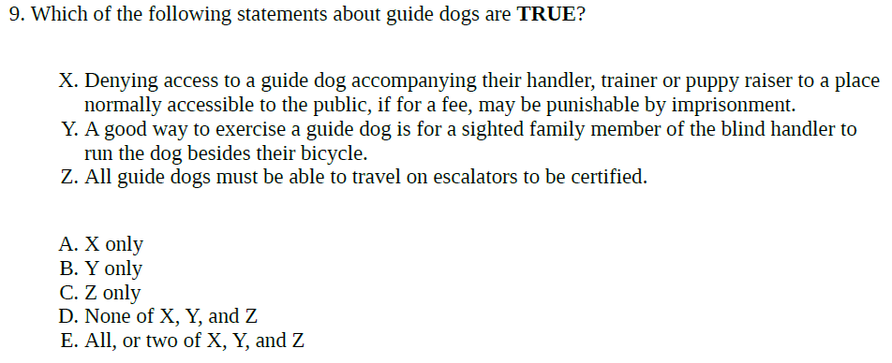
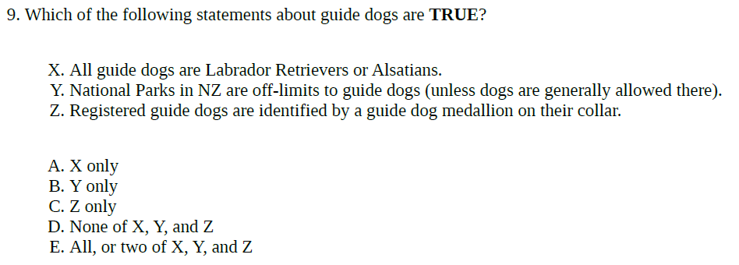
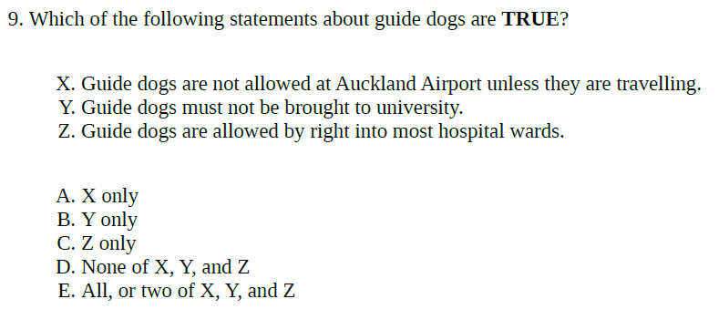
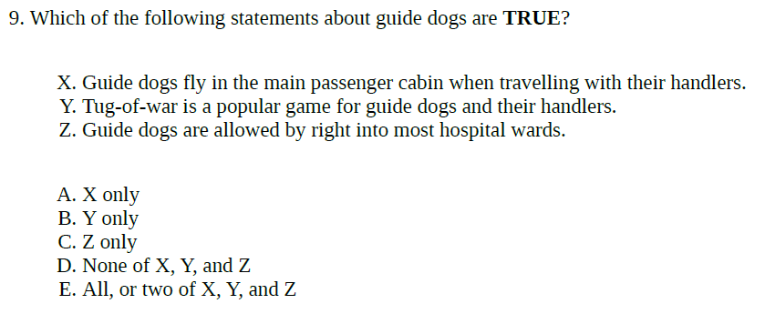
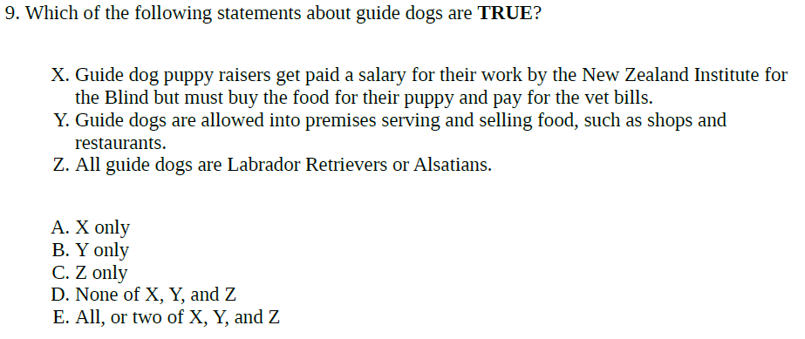
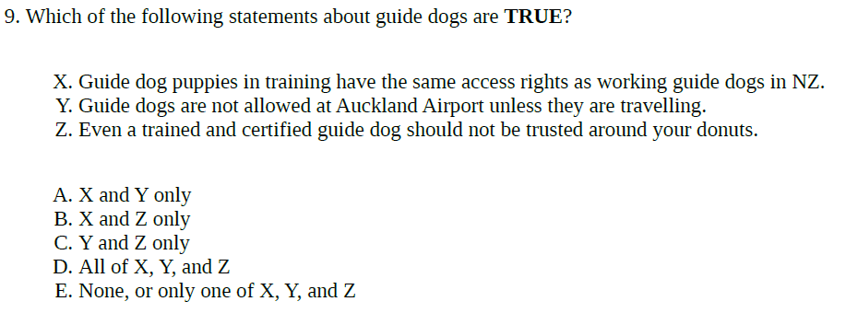
The XYZ question type can be even more challenging:
Notes:
So this question type is what we call an XYZ question. The student sees three statements, X, Y, and Z, and needs to evaluate all three and figure out which combination is correct. For each version, Dividni picks three answer options from the combined pools, and one of two possible answer schemes, randomises the statement order and inserts the result into the script for that particular version.
As it does this for every question that you select to include in your script, each student gets a unique script that is quite different from that of all of their neighbours. Obviously, the larger you make the pools, the less likely that sidewards glances will be rewarding.

Slide 10
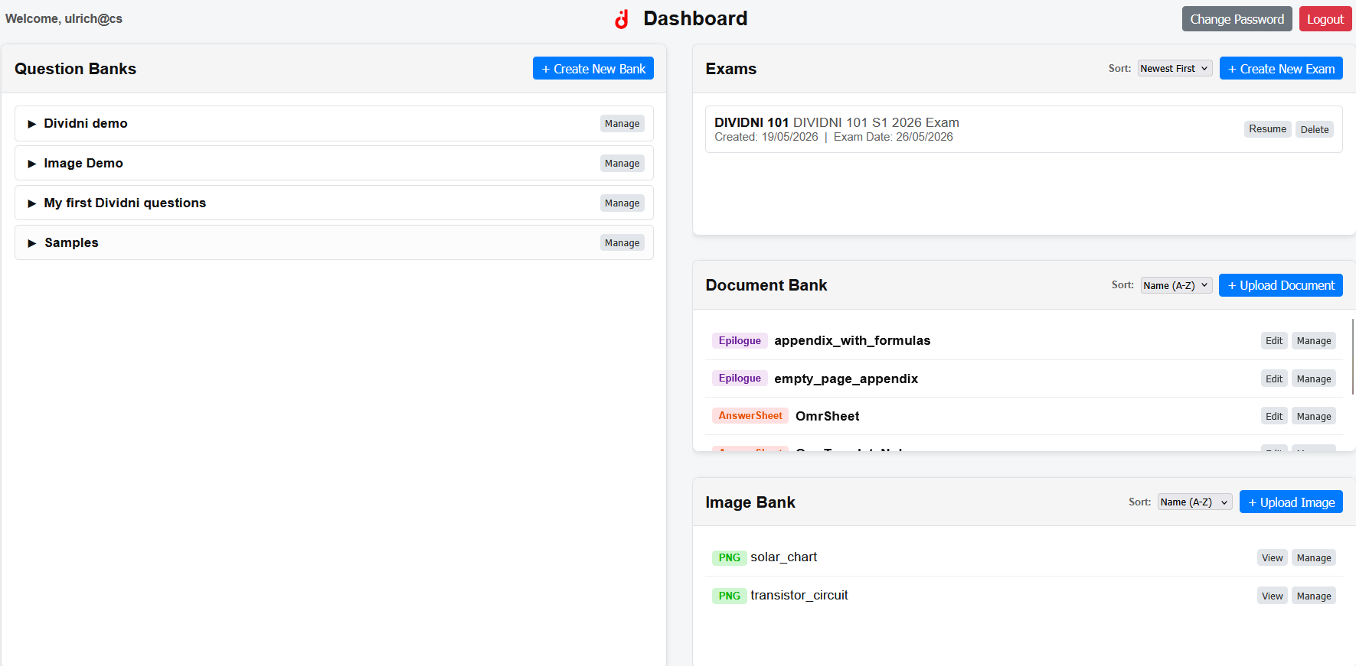
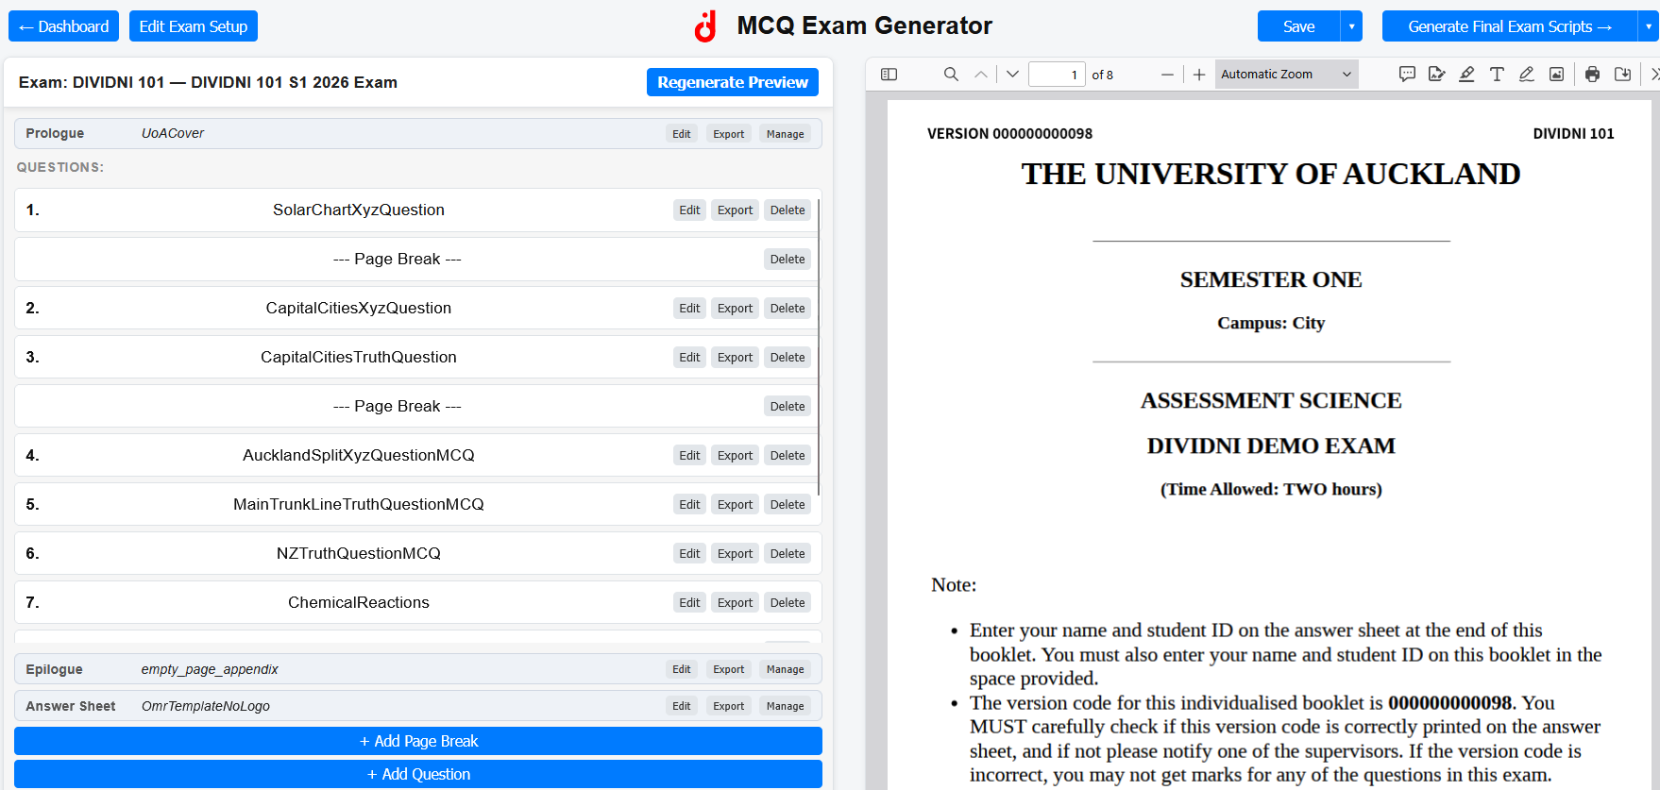
The Dividni MCQ Examn Generator UI:
Notes:
The Dividni MCQ Examn Generator UI lets you add, edit and manage questions and assemble exam scripts. If you already have Dividni questions, you can upload and modify them here.
When assembling scripts, Dividni gives you an immediate preview for version 0 of the script. You can move questions around, insert page breaks, and edit questions, cover sheets, OMR sheets and appendices. When creating or editing questions, you can insert images here, too.
Last but not least, the MCQ Exam Generator UI lets you automatically generate as many versions of your script as you need: 100 or 1000 – Dividni can do.

Slide 11

Students enter their answer into their versioned OMR sheet:
Pre-printed script version field
Student ID
Answers
Notes:
At the end of each script, there is an optical mark recognition sheet that students fill out, or OMR sheet for short. The OMR sheet gets printed as part of the script, the version number on in is pre-printed for the students, and all the students do is add their name, their student ID and their answers. At the end of the test or exam, this OMR sheet is all the students submit.

Slide 12
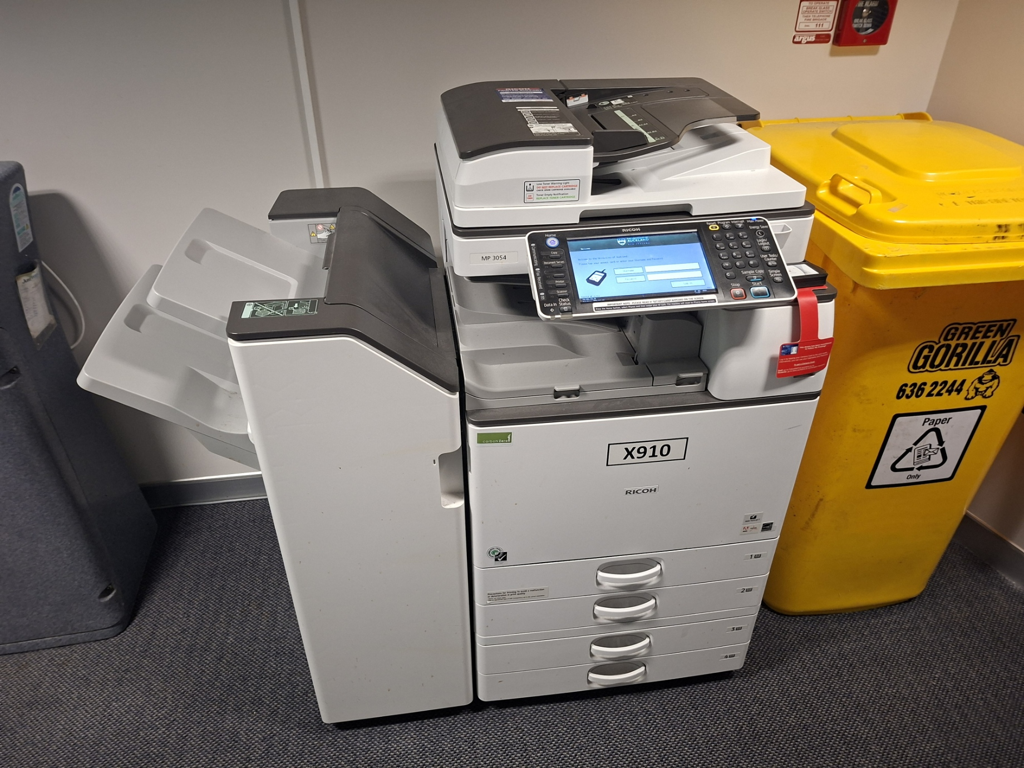
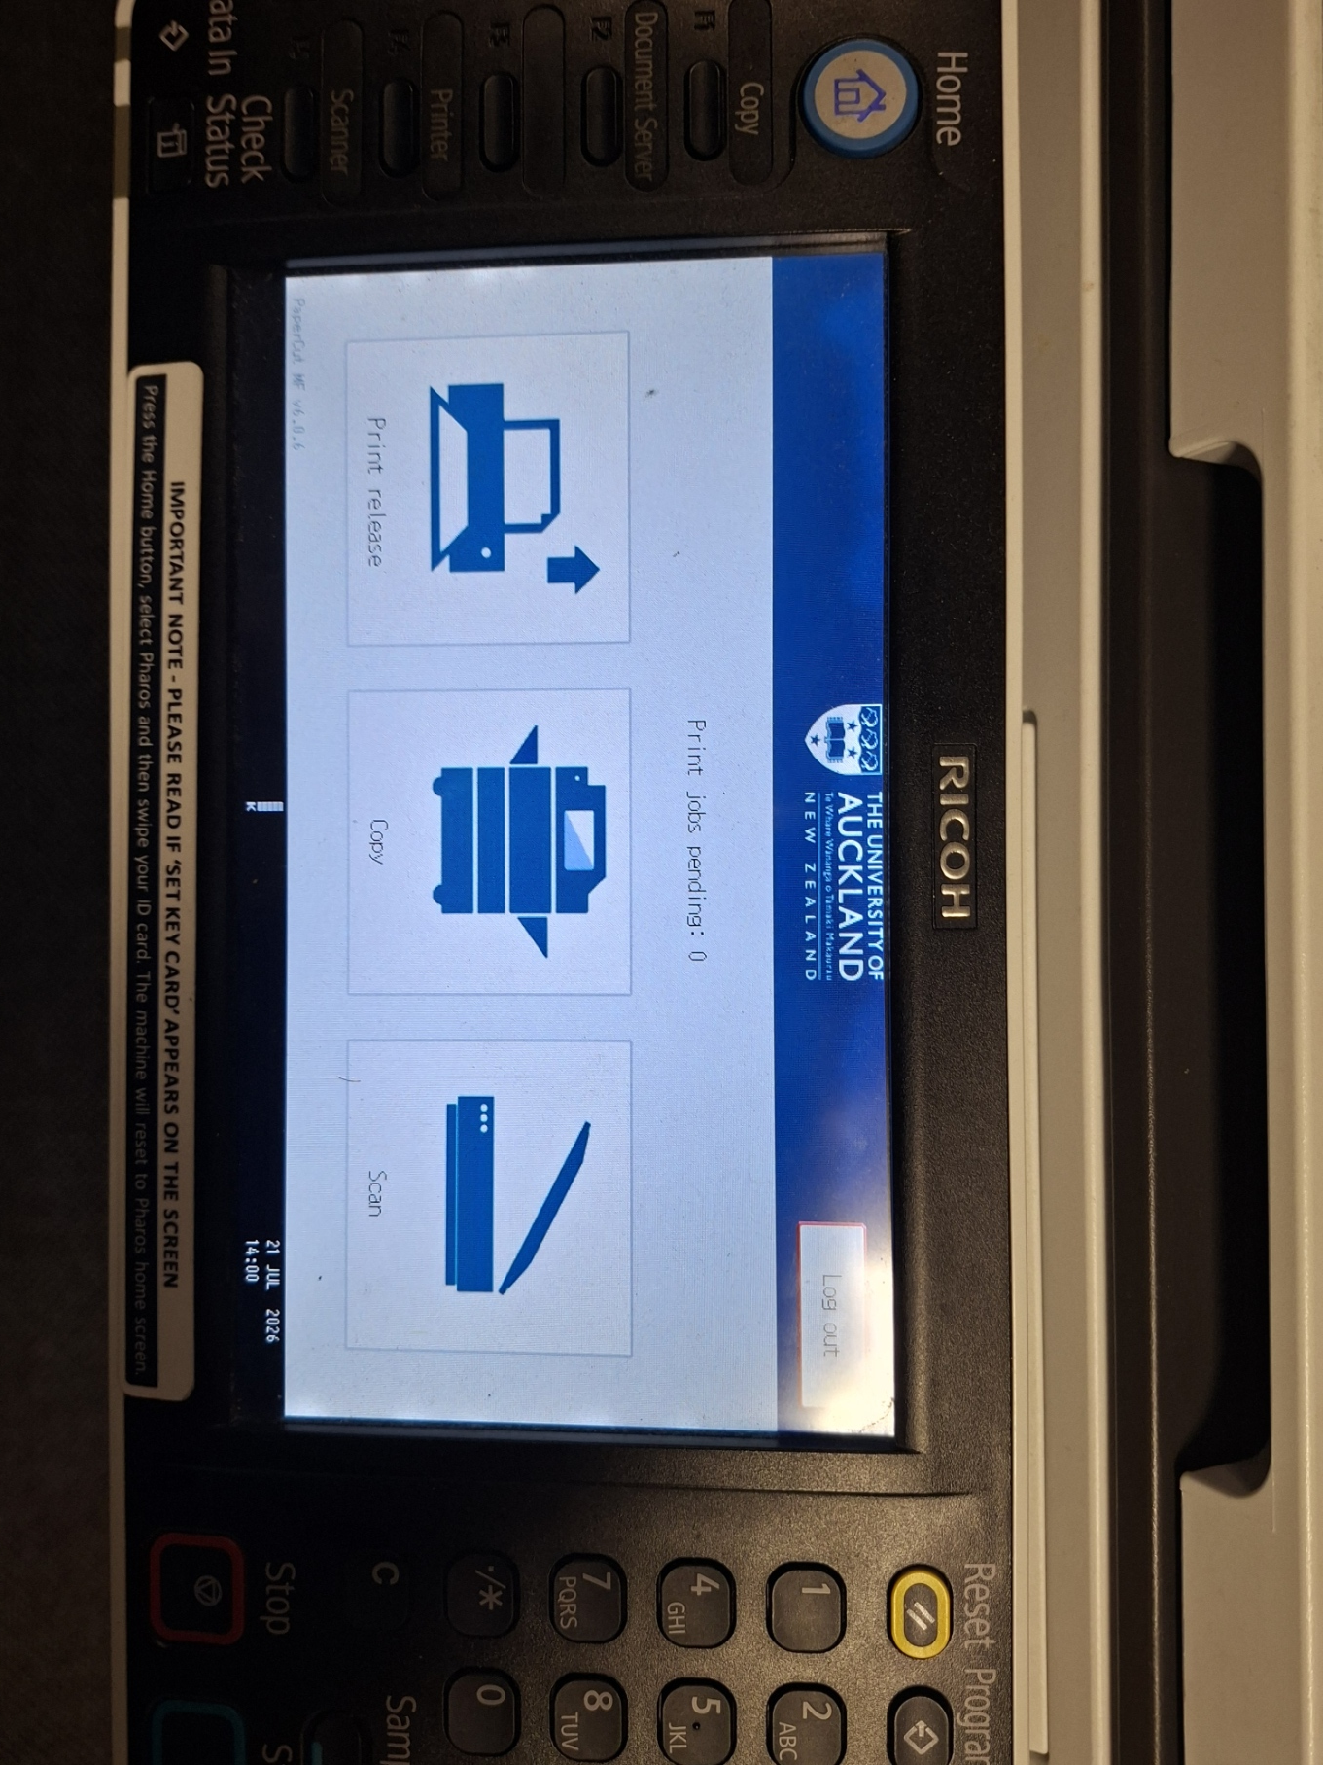
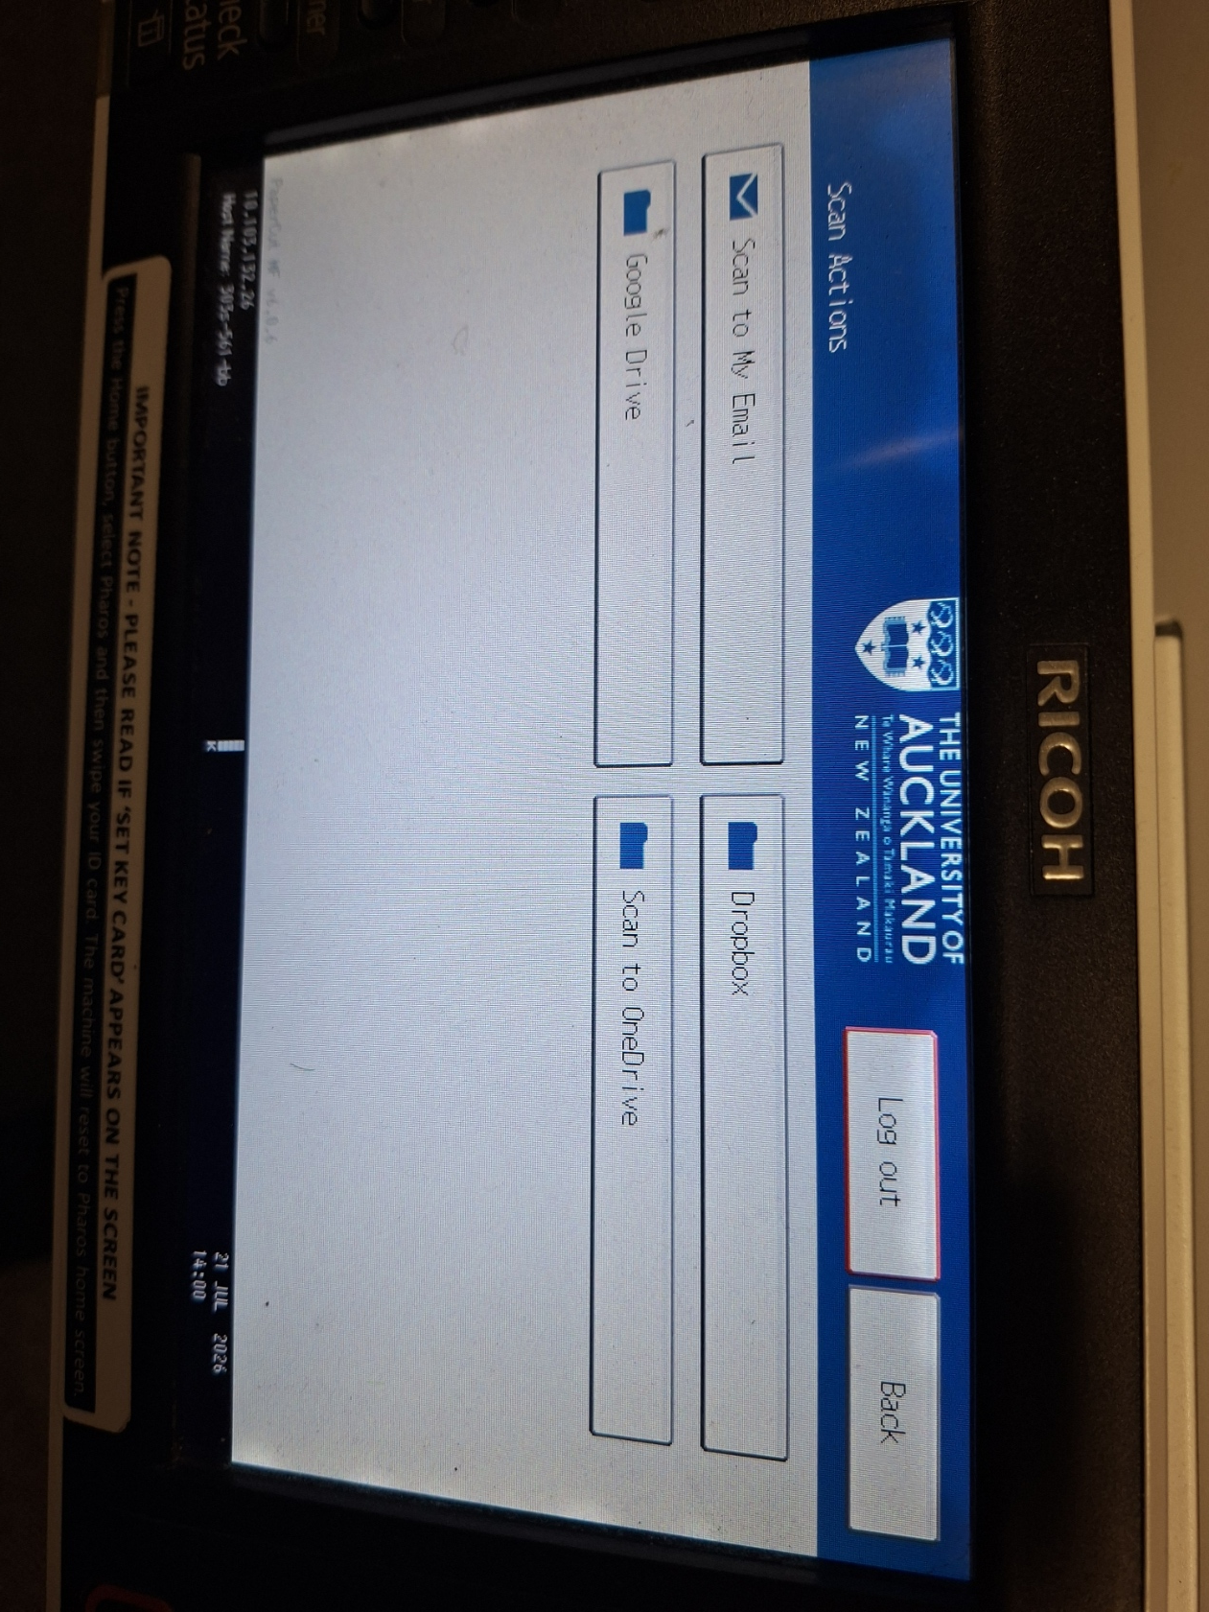
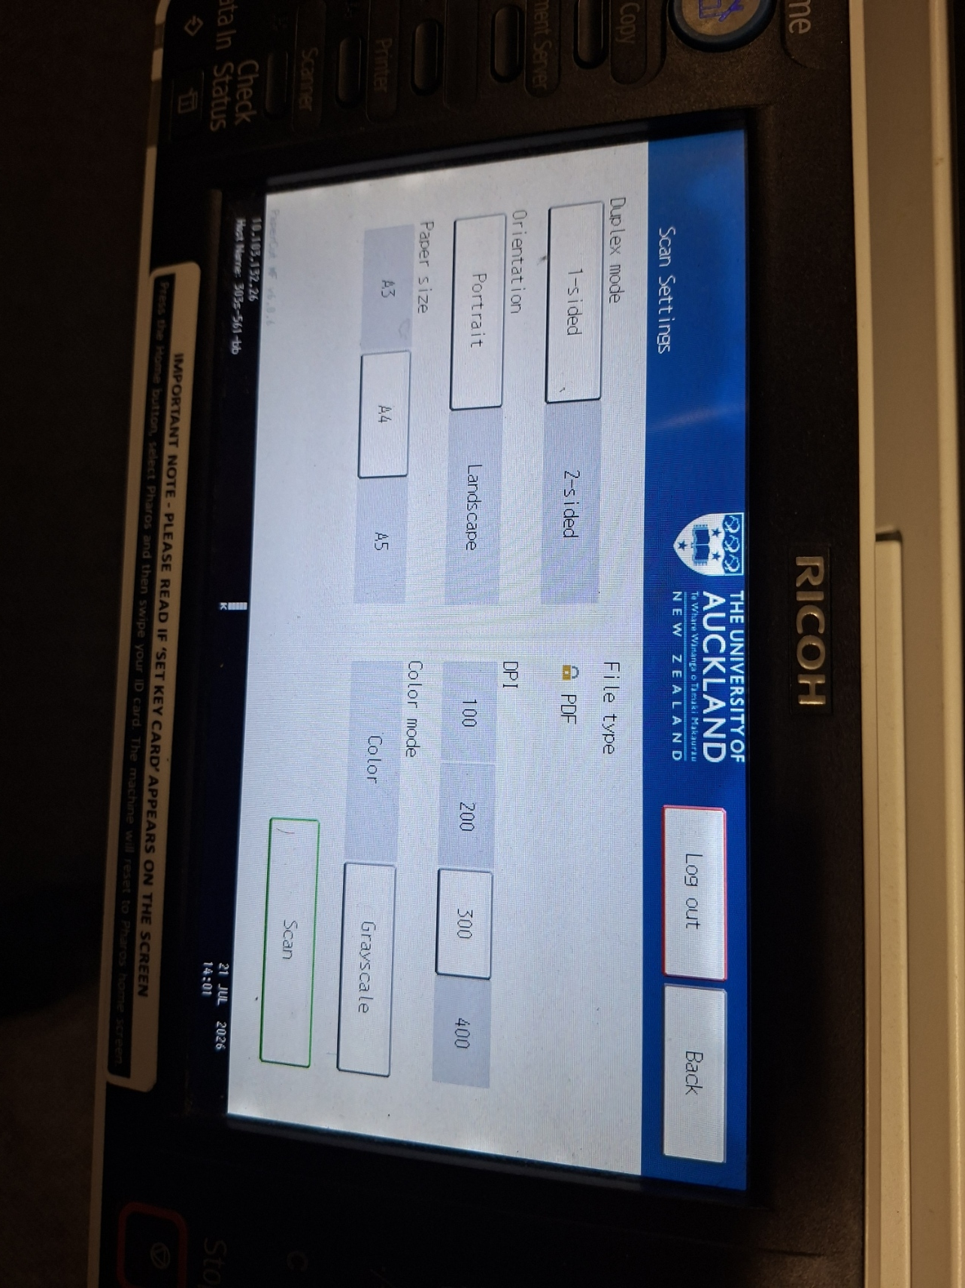
Scan the OMR sheets on any Follow-Me printer-scanner on campus:
Log in with your
blue Campus Card
Scan
… to your OneDrive, Google Drive,
Dropbox or e-mail
300 dpi grayscale
one-sided is ideal
For large classes: Scan in batches
Notes:
Once you have the OMR sheets in hand, you head to a scanner. At the University of Auckland, pretty much any of the ubiquitous Follow-Me printer-scanner-copiers will do – there is bound to be one on a corridor near you, and if there isn’t or it isn’t working, there’ll be another one not far away. They don’t have to look exactly like the one here, but they all have in common that you can log in with your blue Campus Card, choose Scan, then choose whether you’d like to have your scan sent to OneDrive, Google Drive, Dropbox or plain old-fashioned e-mail, adjust the settings – we recommend single side 300 DPI grayscale scanning – and then let the scanner do its thing.

Slide 13
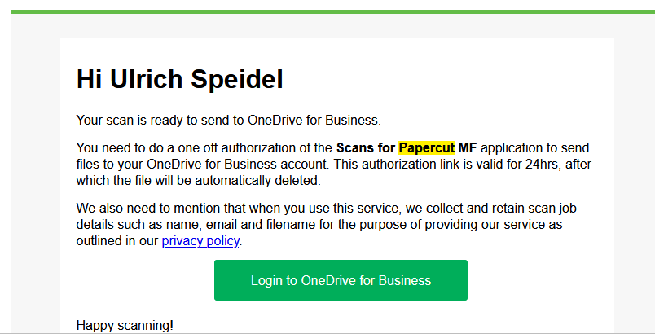
Allow PaperCut MF to place the scans into your OneDrive/Dropbox/Google Drive:
Click here and follow instructions
Notes:
Once it’s done its thing, head to your e-mail and give the application behind the scanning, PaperCut MF, permission to access whatever drive or dropbox you chose (this step isn’t needed for scanning to e-mail but when you scan to e-mail you may need to scan in smaller batches).

Slide 14
Find your scans on OneDrive/Dropbox/Google Drive. For example:
Scans will look somewhat like this:
Notes:
The next step is to find where PaperCut MF has put the scans on OneDrive, Google Drive, or Dropbox on your system – they’ll usually be in a folder called Apps > Scans for PaperCut MF.

Slide 15
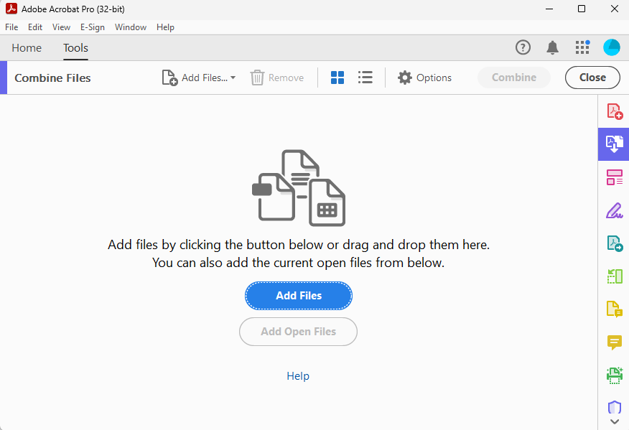
Had to scan in batches? You might wish to combine the scan PDFs:
Adobe Acrobat has
a tool for this!
Just drag the PDF
for each batch into
the window, hit
Combine, and save
the resulting
“Binder” PDF file
to disk
Notes:
If you had to scan in batches – which you’ll likely have to if your class is over 40-50 students – then you may wish to combine the PDF files with the scanned OMR sheets. One option for doing this is Adobe Acrobat, which is usually installed by default on university computers and has a “Combine Files” tool just for this kind of job! This then ends you up with one single big PDF file for further processing.

Slide 16
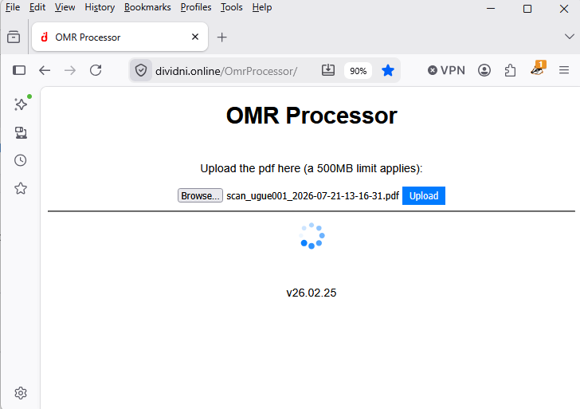
Upload your scan PDFs to the OMR Processor to capture student responses:
N.B.: This can take a minute or five
depending on the number of
students and number of
questions
Notes:
Head to our OMR Processor site and upload that single large PDF file. Dividni’s OMR processor will now try and extract student IDs and answers from the OMR sheet scans. Depending on the number of sheets and the number of questions, this can take a few minutes. As a guide, a 20-question exam for 200 students takes about two minutes to process in this step.

Slide 17
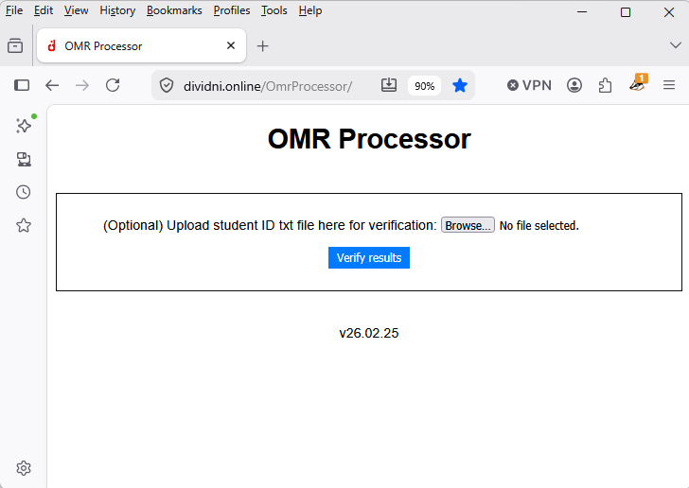
Upload your class list to permit verification:
Notes:
Once the OMR Processor is done, you can – and should! – supply a text file with student names and IDs. You can extract this information from a Canvas grade book export, for example. This information helps Dividni in the next step – the post-processing.
So let’s see what this looks like.

Slide 18
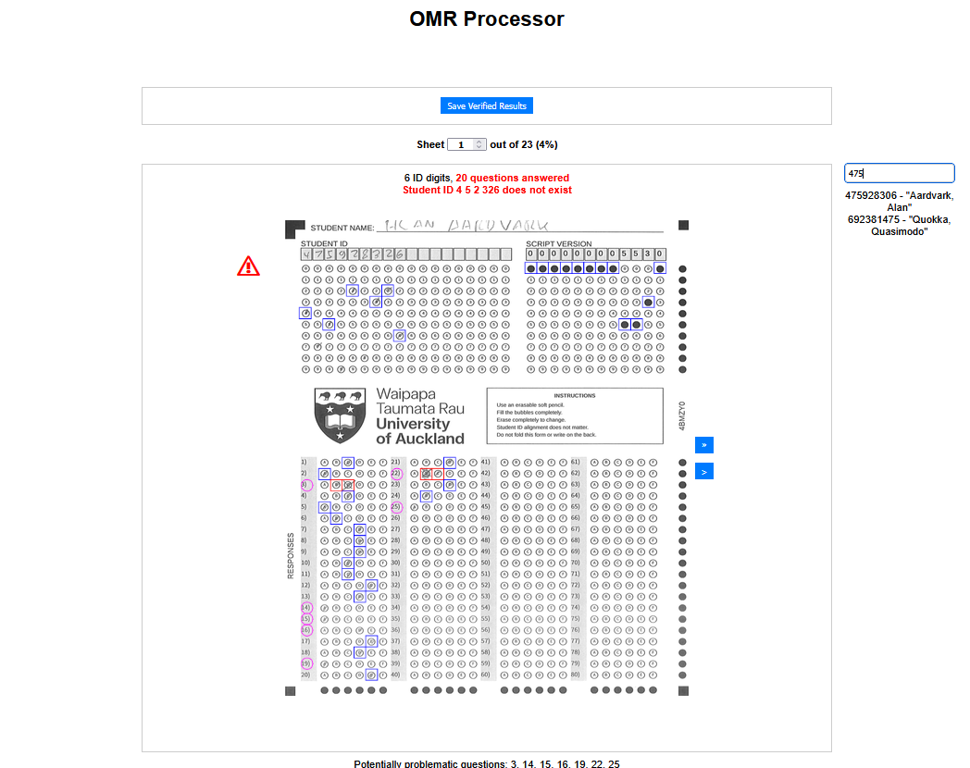
Post-process the OMR sheets in the intuitive OMR Processor UI:
OMR Processor learns
how many answers there
should be
Search for names
and IDs
IDs that can’t be
found in the class
list get flagged
(with suggested
autocorrect where
a close ID exists)
Move to next sheet in scan
Problematic
questions are
highlighted
automatically
and “fixed” by
a simple click
or two
Move to next problem sheet in scan
Notes:
In the post-processing, Dividni’s interactive OMR Processor lets you step through the scans of each sheet – every sheet or just the ones where Dividni has encountered problems, such as an ID that isn’t in the class list you provided, questions that appear not to have been answered or for which students possibly gave more than one answer.
If the ID wasn’t found but a similar ID was, a fix is just one click away. If the problem is worse, you can search by partial ID or by name, and a single mouse click inserts the correct ID. Overlooked answers or double answers are corrected with a click or two.
Once you are done, click on the blue button at the top to download the quality-assured scan results.
In a typical class, post-processing takes about 5-10 minutes per 100 students.

Slide 19
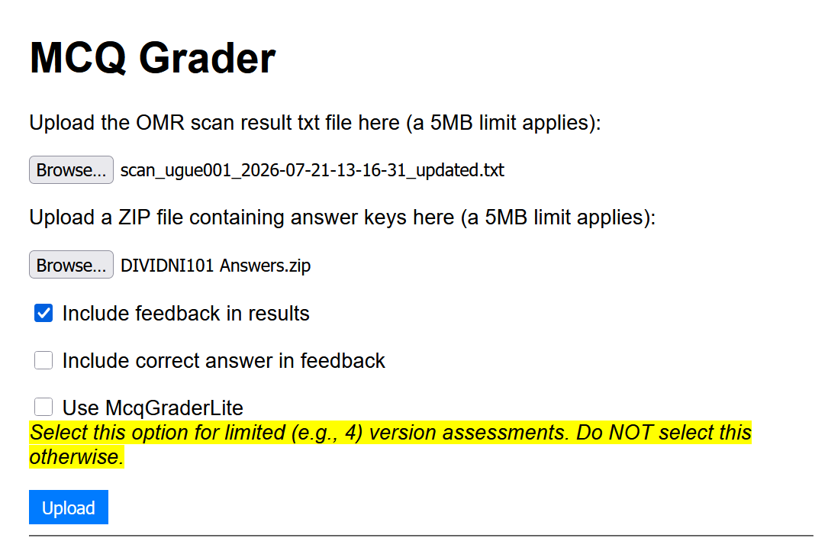
Grade the entire class online in seconds:
Notes:
The MCQ Grader then lets you combine the quality-assured scan results with the ground truth answers you generated with the versioned scripts to grade the test or exam. This only takes a few seconds, even for large classes.
By default, the results contain a file for each student that just notes the answer to each question that was recorded for the student. Optionally, like shown here, Dividni can also include feedback as to whether that answer was correct, and if you wish, include what the correct answer for incorrectly-answered questions would have been. You can e-mail this feedback to students via a separate command line mailout utility.
The output of the MCQ Grader also contains files that let you transfer grades easily into a Canvas gradebook export CSV file for Canvas upload, or to make changes to grades – for example because a question was faulty and you want to give the mark for the question to everyone or no one. You can also use the output to analyse which questions were hard and which ones were easy.

Slide 20
What happens when …?
… students don’t to turn up at the test or exam?
If it’s within a short time frame that doesn’t allow preparation
based on your topic choice, just sit them down with another version
of the test or exam. You can grade this manually using the ground
truth for his version.
If there is more of a time lag, just create a “stragglers version” of the
test / exam with a few versions in which you swap out a small number
of questions.
… one of my questions contains a mistake (e.g., answer option in wrong pool)?
Simply give the marks for the question to all students. One of the files the MCQ Grader
produces for you is a spreadsheet that contains all question marks for all students. Just
put the desired mark value for that question in the appropriate column. Done.
… I’ve lost my ZIP file with the ground truth answers?
If you haven’t changed the test / exam in the UI, you can regenerate the answer keys there.
Notes:
Obviously, tests and exams have snafus – we’ve used Dividni since 2018 and have seen it all.
One of the great things with Dividni is that you can make the different versions so different that the difference between two scripts is comparable to the difference between what used to be this year’s exam and last year’s exam. At this point, every script version is basically like a new exam, and so you can simply use spare or extra version to handle students who for whatever reason weren’t able or willing to turn up on the day, or had a bad hair day and come with an aegrotat. Providing replacement exams and re-sits is now the easy option.
This also puts a stop to attempts at obtaining fake aegrotats because these essentially give no advantage to students who just have to sit another exam they haven’t seen before.
Obviously, we all make mistakes sometimes, and sooner or later you’ll have students pointing out to you that a question had no or multiple correct answers. We usually give everyone in the class the marks for these, and that’s fairly easily done after the MCQ Grader step.
Similarly, as long as your exam hasn’t been modified since you generated the versions, the ground truth answers can be regenerated should you lose them. It just takes a little while for large classes!

Slide 21
Dividni takes the pain out of assessment by letting you:
Create questions that spawn a huge number of different question versions to make cheating difficult. Make learning the more attractive option.
Cuts down on test / exam preparation time by being able to re-use questions that barely age. Create tests / exams in an hour or two not days.
Seat students on every seat in your normal lecture theatre during normal class time. No more booking and staffing headaches. Get your evenings back.
Handle latecomers, missed tests / exams and aegrotats with ease. Measure, don’t muddle through.
Use almost any scanner to go from paper back to digital. No more specialised equipment bottlenecks.
Scan, process and grade even large exams on the same day. Get them off your desk quick smart.
Enhance student experience with prompt feedback. In hours not weeks.
Provide assessment on demand – if you wish. Fresh test / exam copies for everyone.
Notes:
As you’ve probably realised by now, Dividni takes away a lot of the pain points in assessment.
It combines the security of in-person assessments with the convenience of digital, and relieves you of a lot of the bottlenecks and paint points normally associated with exams.
It’s better for the student experience – authentic assessment with quick feedback turnaround. It’s easy on your colleagues and your real estate footprint. It’s fast and opens options you haven’t ever had before.

Slide 22
But wait, there’s more:
Question stems and pools don’t have to be static!
With a little programming (our students can help!), you can create parameterised question stems
and answer pools randomly on the fly. Great for numerical questions and similar problem-solving
questions.
Even questions with randomised graphics are possible.
Let your favourite AI bot write your questions
Mano’s MegaPrompt lets you supply your material to your favourite AI bot (ChatGPT, Claude,
Gemini etc.) to create questions for your students to solve. This can even do parameterised
questions. You only do the proofreading!
Notes:
What we haven’t mentioned thus far is that questions don’t have to be static. With a little bit of programming, it’s possible to include numerical questions or others that absolutely cannot be solved by memorising anything. We’ve even done questions that include randomised graphs. The sky is really the limit here.
Now if you’ve been a bit suspicious when your students head over to an AI bot “for ideas”, Mano’s “mega prompt” lets you do the same when writers block hits. Even better, it lets the bots tailor questions to your own course material.

Slide 23
Think Dividni might be for you?
Launch headlong into DIVIDNI 101!
Notes:
Well, we hope that Dividni might be able to help you in your assessments.
If we’ve stirred your interest, have a look at the other modules here in DIVIDNI 101 to get you up and running in no time!

